Slide 1
“Introduction to the Stochastic modelling of reaction networks” Day 1: The Gillespie algorithm (intro)
Manuel Lera Ramírez
manuel.lera@embl.de
CBB – François Nédélec Group

Slide 2
Deterministic vs. stochastic
Deterministic: every set of variable states is uniquely determined by parameters in the model and by sets of previous states of these variables; therefore, a deterministic model always performs the same way for a given set of initial conditions.
Stochastic trajectory: randomness is present, and every trajectory can be different from the others.
Stochastic: calculate deterministically some variable of the stochastic distribution

Slide 3
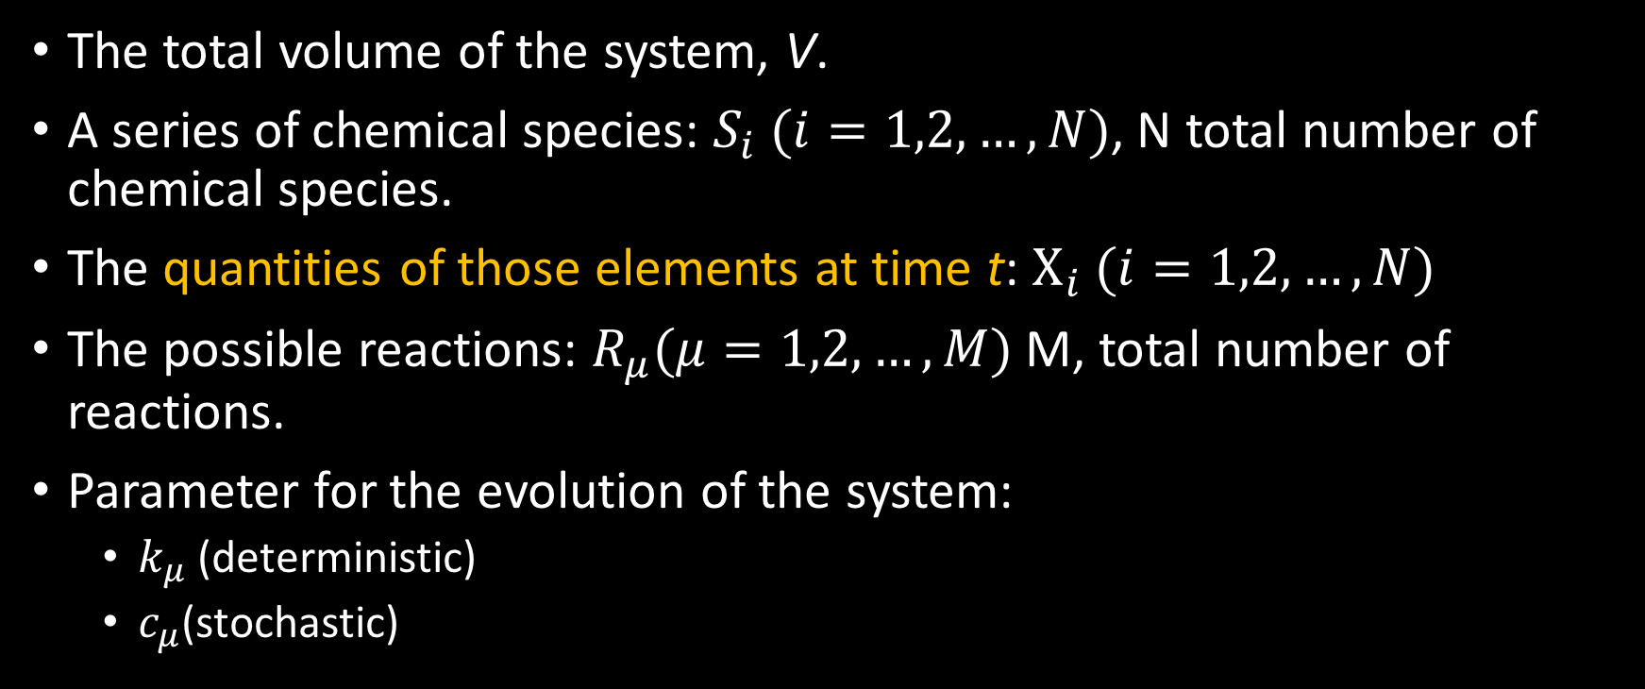
Notation: Describing a chemical system over time
The total volume of the system, V.
A series of chemical species: $S_{i} (i=1,2,…, N)$, N total number of chemical species.
The quantities of those elements at time t: $X_{i} (i=1,2,…, N)$
The possible reactions: $R_{μ}(μ=1,2,…,M)$M, total number of reactions.
Parameter for the evolution of the system:
$k_{μ}$(deterministic)
$c_{μ}$(stochastic)

Slide 4
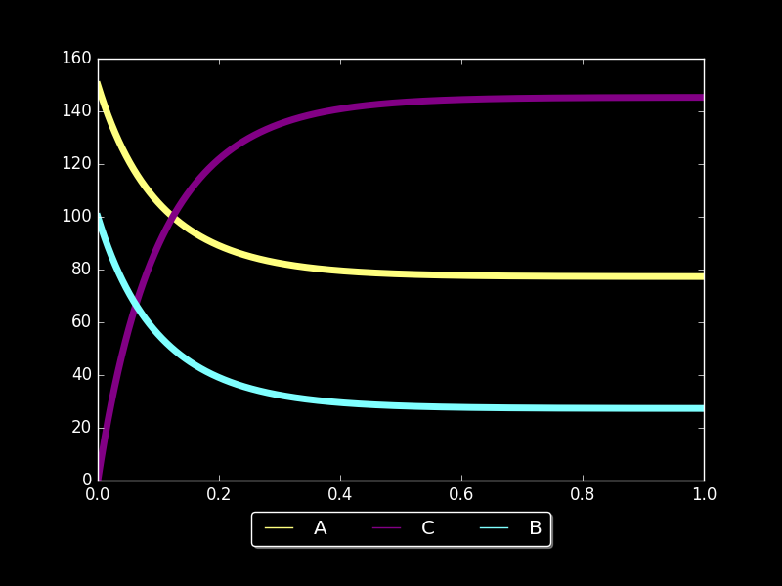
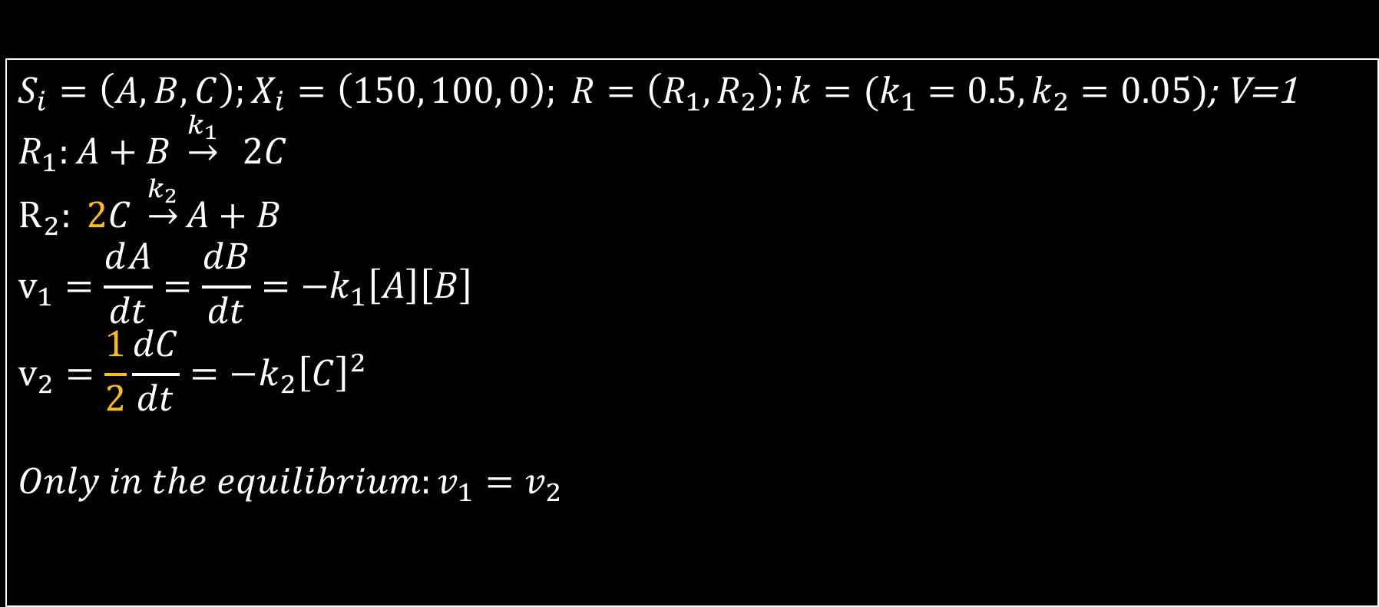
The deterministic approach to chemical reactions
Back to high-school: A simple equilibrium
$S_{i}=\left(A,B,C\right);X_{i}=\left(150, 100, 0\right); R=\left(R_{1}, R_{2}\right);k=(k_{1}=0.5,k_{2}=0.05)$; V=1
$R_{1}:A+B \underset{→}{k_{1}} 2C$ $$R_{2}: 2C \underset{→}{k_{2}}A+B \\ v_{1}=\frac{ⅆA}{dt}=\frac{dB}{dt}=−k_{1}\left[A\right]\left[B\right] \\ v_{2}=\frac{1}{2}\frac{dC}{dt}=−k_{2}{\left[C\right]}^{2}$$
$$Only in the equilibrium:v_{1}=v_{2}$$

Slide 5
A stochastic approach to the chemical system
Time evolution of a chemical system is not continuous, chemical species quantities can only change by discrete integer amounts.
It is not deterministic if we take into account only the quantities of the chemical species. It is impossible to predict the exact molecular population levels at a future time.
A better approach is to consider the process as a random walk

Slide 6
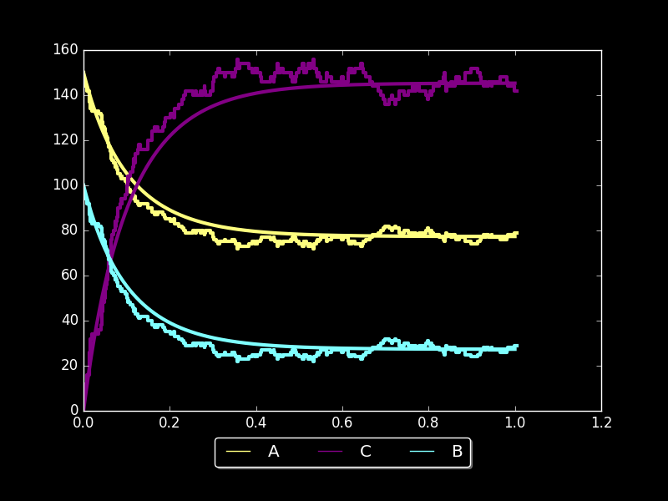

Stochastic model assumptions
The volume V is fixed
The molecules are in thermal equilibrium, collisions occur in a random manner. The mixture is spatially homogeneous.
A reaction happens when two interacting molecules collide in an "appropriate way”.
$R_{1}:A+B \underset{→}{k_{1}} 2C$ $$R_{2}: 2C \underset{→}{k_{2}}A+B \\ \frac{{dP}_{1}}{dt}=c_{1}n_{A}n_{B} \\ \frac{{dP}_{2}}{dt}=\frac{c_{1}n_{C}\left(n_{c}−1\right)}{2}$$

Slide 7
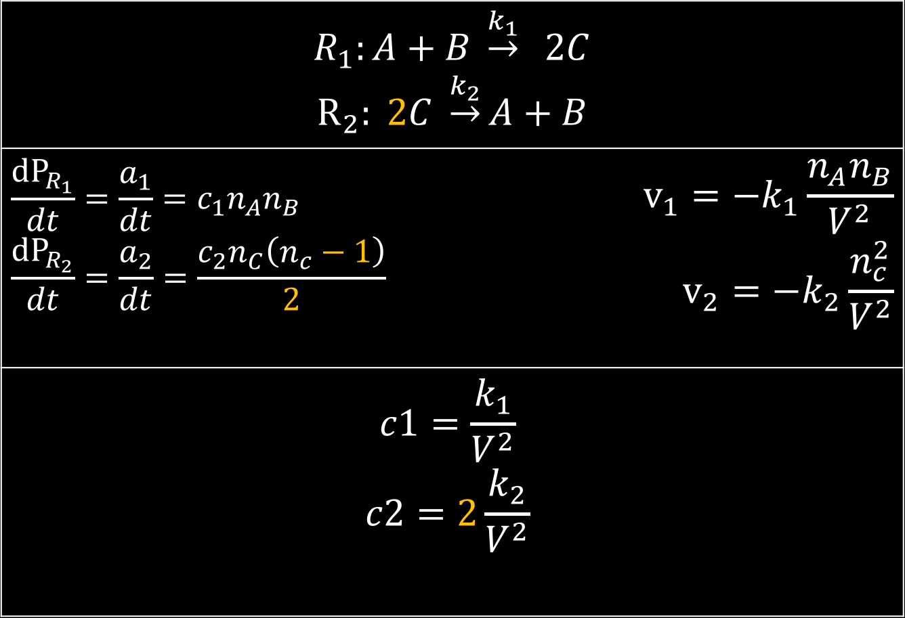
Possible combinations
$R_{1}:A+B \underset{→}{k_{1}} 2C$ $$R_{2}: 2C \underset{→}{k_{2}}A+B$$
$$\frac{{dP}_{R_{1}}}{dt}=\frac{a_{1}}{dt}=c_{1}n_{A}n_{B} \\ \frac{{dP}_{R_{2}}}{dt}=\frac{a_{2}}{dt}=\frac{c_{2}n_{C}\left(n_{c}−1\right)}{2}$$ | $$v_{1}=−k_{1}\frac{n_{A}n_{B}}{V^{2}} \\ v_{2}=−k_{2}\frac{n_{c}^{2}}{V^{2}}$$
$$c1=\frac{k_{1}}{V^{2}}$$ $$c2=2\frac{k_{2}}{V^{2}}$$
Units?
Volume effect?

Slide 8
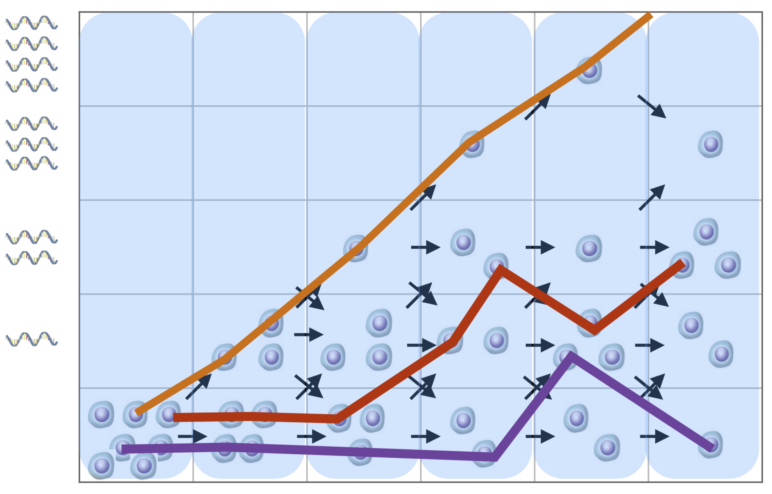
Master equation vs. stochastic simulation algorithm
Master equation: Probability distribution over time
Stochastic simulation: Calculates a particular trajectory

Slide 10
The Gillespie algorithm
Basically, we can simulate the evolution of a chemical system by repeatedly asking this two following questions:
Which reaction will happen next?
When will it happen?
How to find the response to them?
This is the main goal of this session

Slide 11
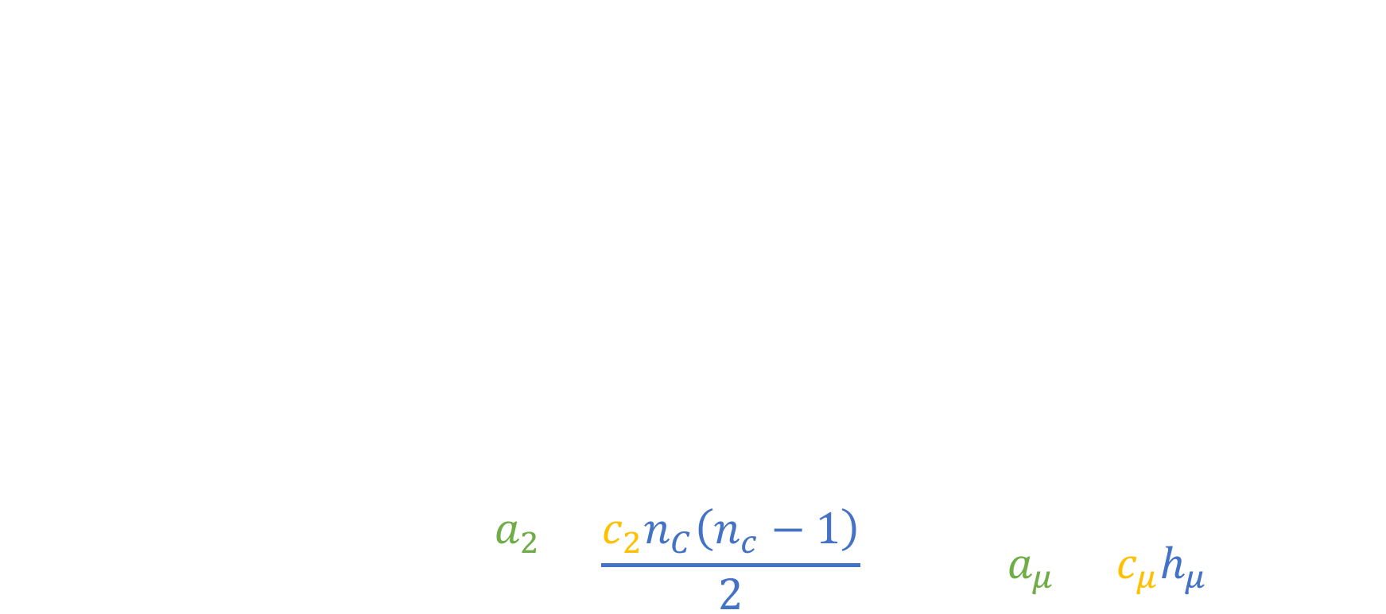
The Gillespie algorithm: First, Refreshment
The total volume of the system, V.
A series of chemical species: $S_{i} (i=1,2,…, N)$, N total number of chemical species.
The quantities of those elements at time t: $X_{i} (i=1,2,…, N)$
The possible reactions: $R_{μ}(μ=1,2,…,M)$M, total number of reactions.
Parameter for the evolution of the system: $c_{μ}$(stochastic)
$$R_{2}: 2C \underset{→}{k_{2}}A+B ;\frac{a_{2}}{dt}=\frac{c_{2}n_{C}\left(n_{c}−1\right)}{2}→R_{μ}: a_{μ}=c_{μ}h_{μ}dt$$

Slide 12
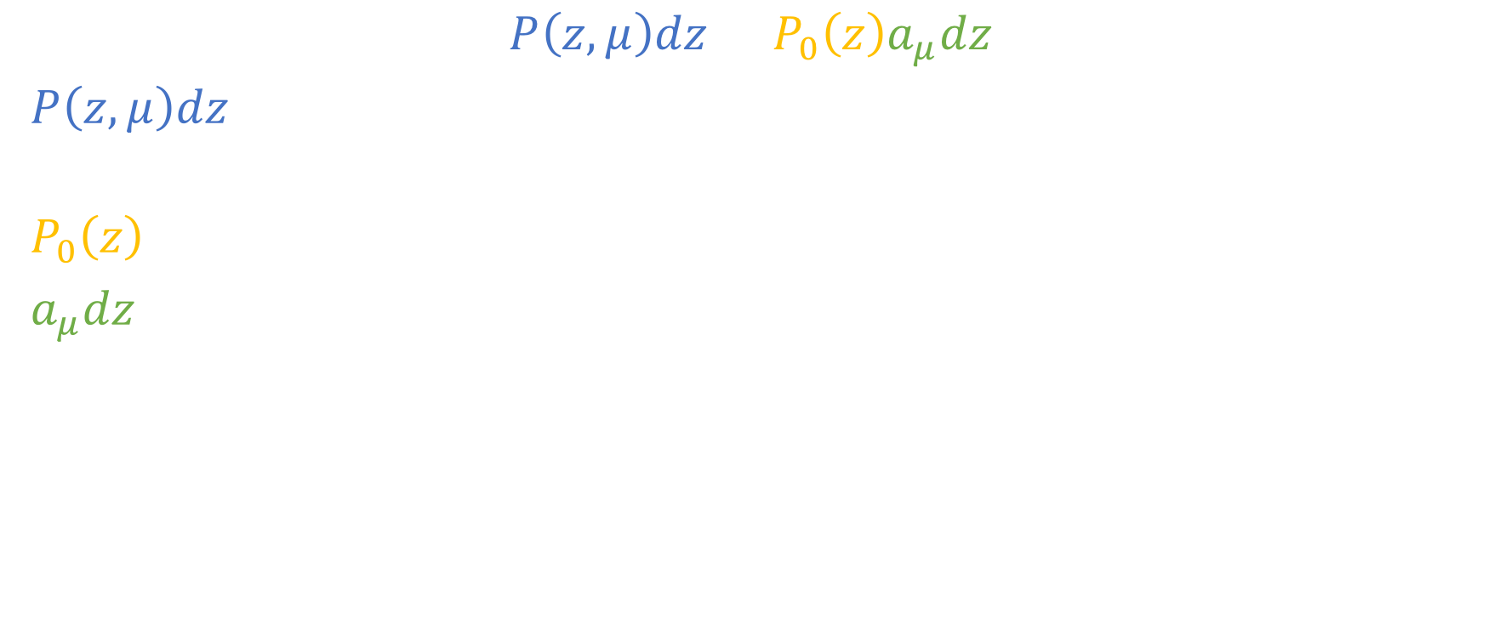
The Gillespie algorithm:
$$P\left(z,μ\right)dz=P_{0}\left(z\right)a_{μ}dz$$
$P\left(z,μ\right)dz$ : probability that no reaction happens in the interval (t, t+z), and THE NEXT reaction happens in the interval (t+z,t+z+dz) and it's $R_{μ}$.
$P_{0}\left(z\right)$ : probability that no reaction happens in interval (t, t+z)
$a_{μ}dz$ : probability that THE NEXT reaction happens in the interval (t+z,t+z+dz) and it's $R_{μ}$.
Reaction!
No reaction
t+z+dz
t
t+z

Slide 13
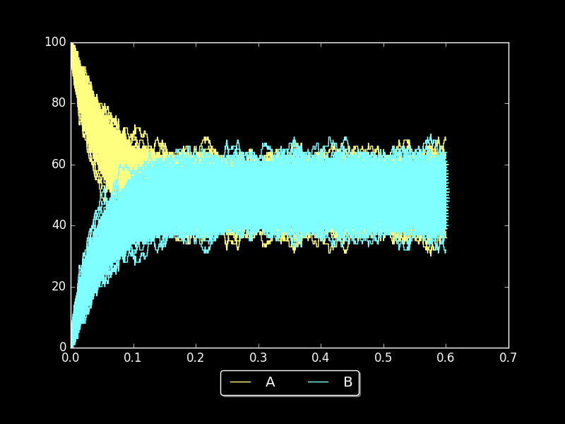

The Gillespie algorithm: what is $P\left(z,μ\right)dz$?

Slide 14
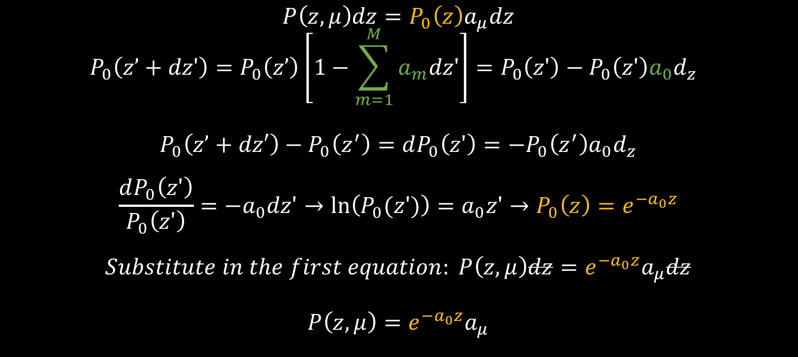
The Gillespie algorithm
$$P\left(z,μ\right)dz=P_{0}\left(z\right)a_{μ}dz$$
$$P_{0}\left(z’+dz'\right)=P_{0}\left(z’\right)\left[1−\sum_{m=1}^{M}{a_{m}dz'}\right]=P_{0}\left(z'\right)−P_{0}\left(z'\right)a_{0}d_{z}$$
$$P_{0}\left(z’+dz′\right)−P_{0}\left(z^{′}\right)=dP_{0}\left(z'\right)=−P_{0}\left(z^{′}\right)a_{0}d_{z}$$
$$\frac{dP_{0}\left(z'\right)}{P_{0}\left(z'\right)}={−a}_{0}dz'→\ln\left(P_{0}(z')\right)=a_{0}z'→P_{0}\left(z\right)=e^{−a_{0}z}$$
$$Substitute in the first equation: P\left(z,μ\right)dz=e^{−a_{0}z}a_{μ}dz$$
$$P\left(z,μ\right)=e^{−a_{0}z}a_{μ}$$
Probability
of no reaction
No
No reaction
z'+dz'
0
z'
No
No reaction
z'+dz'
0
z'

Slide 15
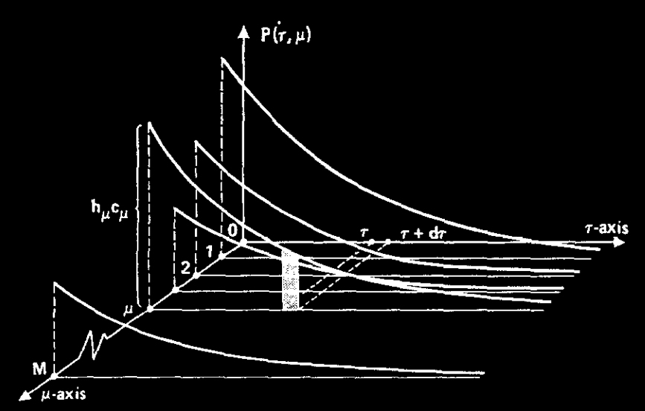

The Gillespie algorithm
$P\left(z,μ\right)=e^{−a_{0}z}a_{μ}$is a probability density function
What does it describe?
Why is it an exponential?
Is it useful for our purpose?

Slide 16
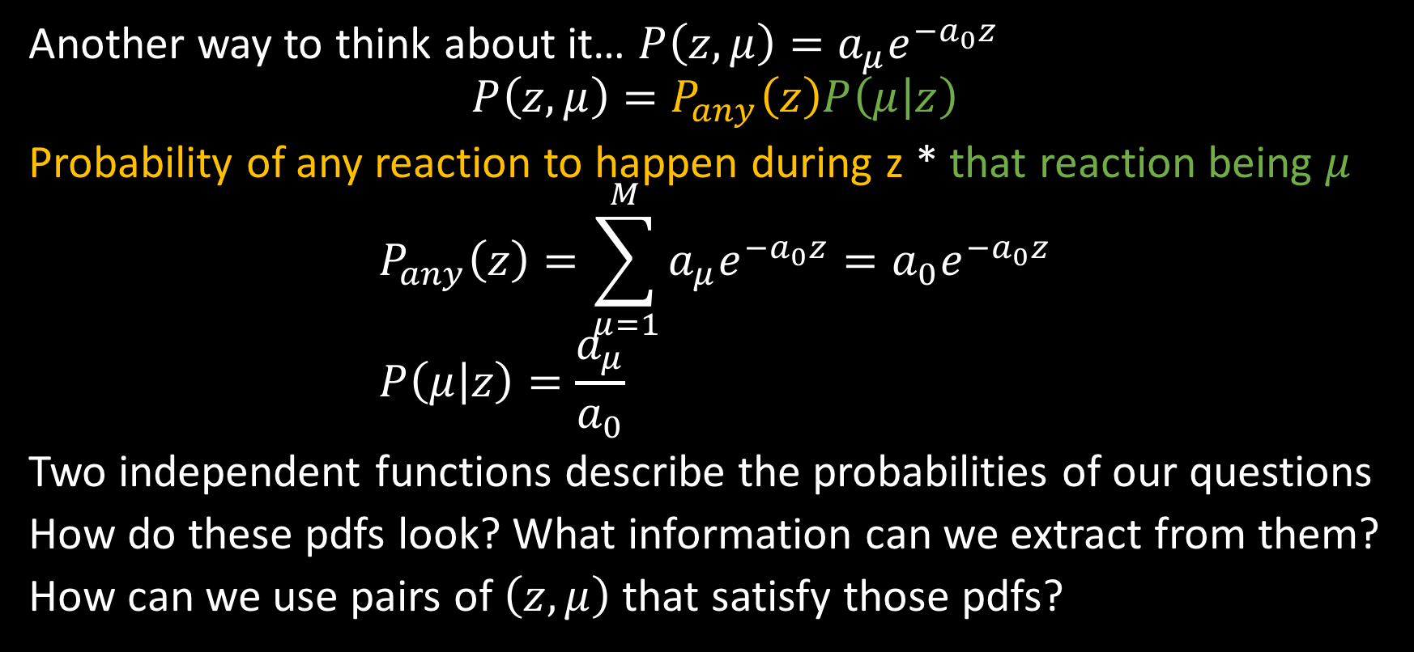
The Gillespie algorithm
Another way to think about it… $P\left(z,μ\right)=a_{μ}e^{−a_{0}z}$
$$P\left(z,μ\right)=P_{any}\left(z\right)P\left(μ | z\right)$$
Probability of any reaction to happen during z * that reaction being $μ$
$$P_{any}\left(z\right)=\sum_{μ=1}^{M}{a_{μ}e^{−a_{0}z}}=a_{0}e^{−a_{0}z} \\ P\left(μ | z\right)=\frac{a_{μ}}{a_{0}}$$
Two independent functions describe the probabilities of our questions
How do these pdfs look? What information can we extract from them?
How can we use pairs of $\left(z,μ\right)$ that satisfy those pdfs?

Slide 17
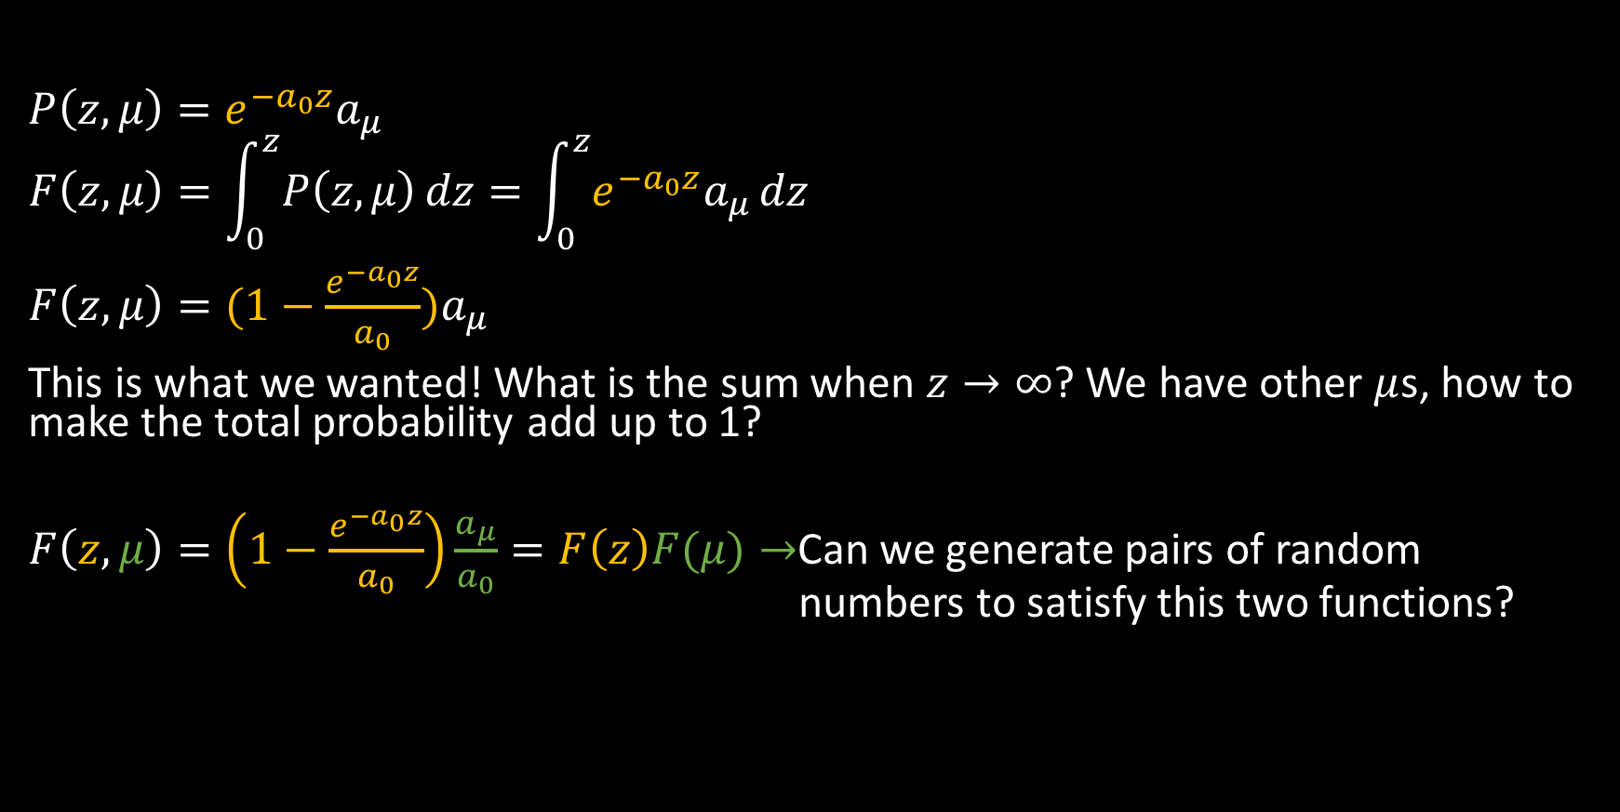
The Gillespie algorithm
$$P\left(z,μ\right)=e^{−a_{0}z}a_{μ} \\ F\left(z,μ\right)=\int_{0}^{z}{P\left(z,μ\right)}dz=\int_{0}^{z}{e^{−a_{0}z}a_{μ}}dz$$ $F\left(z,μ\right)=(1−\frac{e^{−a_{0}z}}{a_{0}})a_{μ}$
This is what we wanted! What is the sum when $z→∞$? We have other $μ$s, how to make the total probability add up to 1?
$F\left(z,μ\right)=\left(1−\frac{e^{−a_{0}z}}{a_{0}}\right)\frac{a_{μ}}{a_{0}}=F\left(z\right)F(μ)→$Can we generate pairs of random numbers to satisfy this two functions?

Slide 18
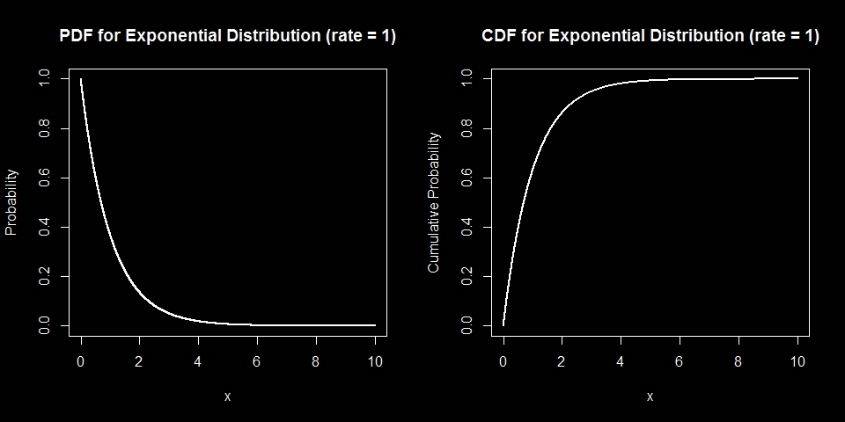
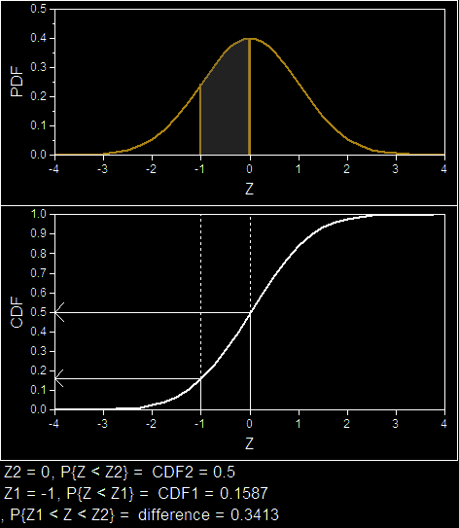

How to sample random values from a PDF
$$P_{any}\left(z\right)=a_{0}e^{−a_{0}z}$$
$$P\left(μ | z\right)=\frac{a_{μ}}{a_{0}}$$
1
Sampling doing F(x)=random number

Slide 19
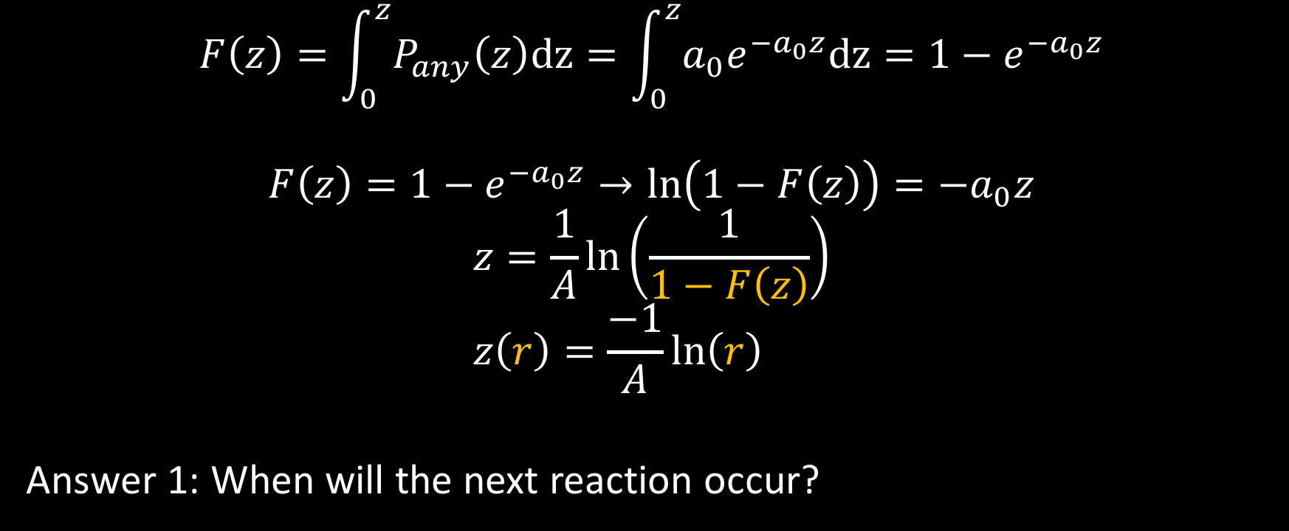
How to sample values from a PDF
$$F\left(z\right)=\int_{0}^{z}{P_{any}\left(z\right)dz}=\int_{0}^{z}{a_{0}e^{−a_{0}z}dz}=1−e^{−a_{0}z}$$
$$F\left(z\right)=1−e^{−a_{0}z}→\ln\left(1−F\left(z\right)\right)=−a_{0}z$$
$$z=\frac{1}{A}\ln\left(\frac{1}{1−F\left(z\right)}\right) \\ z\left(r\right)=\frac{−1}{A}\ln\left(r\right)$$
Answer 1: When will the next reaction occur?

Slide 20






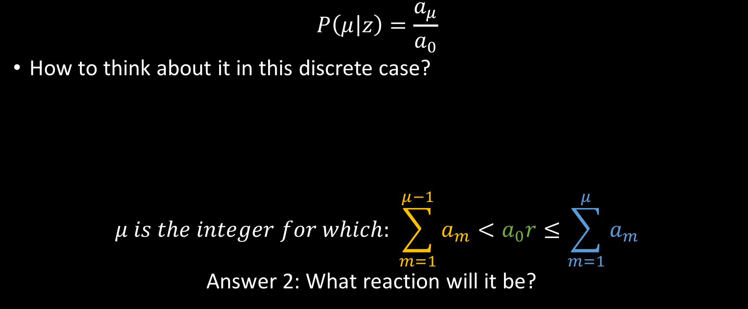
How to sample values from a PDF
$$P\left(μ | z\right)=\frac{a_{μ}}{a_{0}}$$
How to think about it in this discrete case?
$$μ is the integer for which: \sum_{m=1}^{μ−1}{a_{m}}<a_{0}r≤\sum_{m=1}^{μ}{a_{m}}$$
Answer 2: What reaction will it be?
$$a_{1}$$
$$a_{2}$$
$$a_{3}$$
$$a_{4}$$
$$a_{5}$$
$$a_{0}$$

Slide 21
Possible projects
Try it on your own data
Build master equation
Think of an example and compare stochastic and deterministic results
How does tau change with time in different situations?
Suggestions?

